Slide 1


Experience-Based Prediction of Unknown Environments for Enhanced Belief Space Planning
Omri Asraf
under the supervision of Asst. Prof. Vadim Indelman
Notes:
Thanks to…
Today we will talk on Experience-Based Prediction of Unknown Environments for Enhanced Belief Space Planning.
I would like to note before we begin that we presented this work in March at the last IACAS conference. And we submitted to the IROS conference and the RAL journal, we haven't received any answers yet but expect positive answers soon. Lets Start…

Slide 2
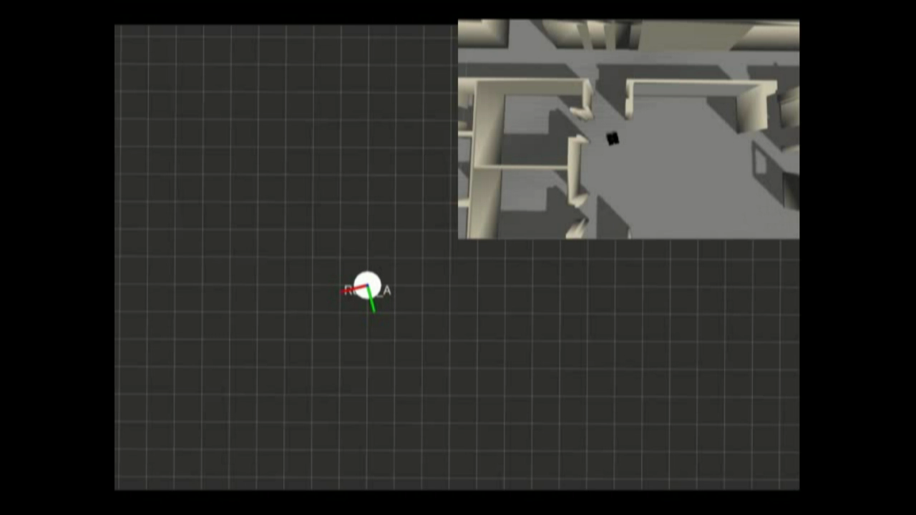
Introduction – SLAM
Notes:
In Autonomous navigation in an unknown environment the agent starts from a point where it has no information about the environment. Simultaneous localization and mapping (SLAM) is a main approach to address this problem. (play the video) Using SLAM, an agent deals with two missions at the same time, first it perceives the surrounding environment using its sensors (for example: cameras and laser scans) and creates a representation of the map. Second, the agent estimates its pose relative to this map. Notice that the measurements are noisy and therefore the states are represented by distributions. The pose could be represented by a Gaussian and here you can see the uncertainty covariance of the last pose.

Slide 3
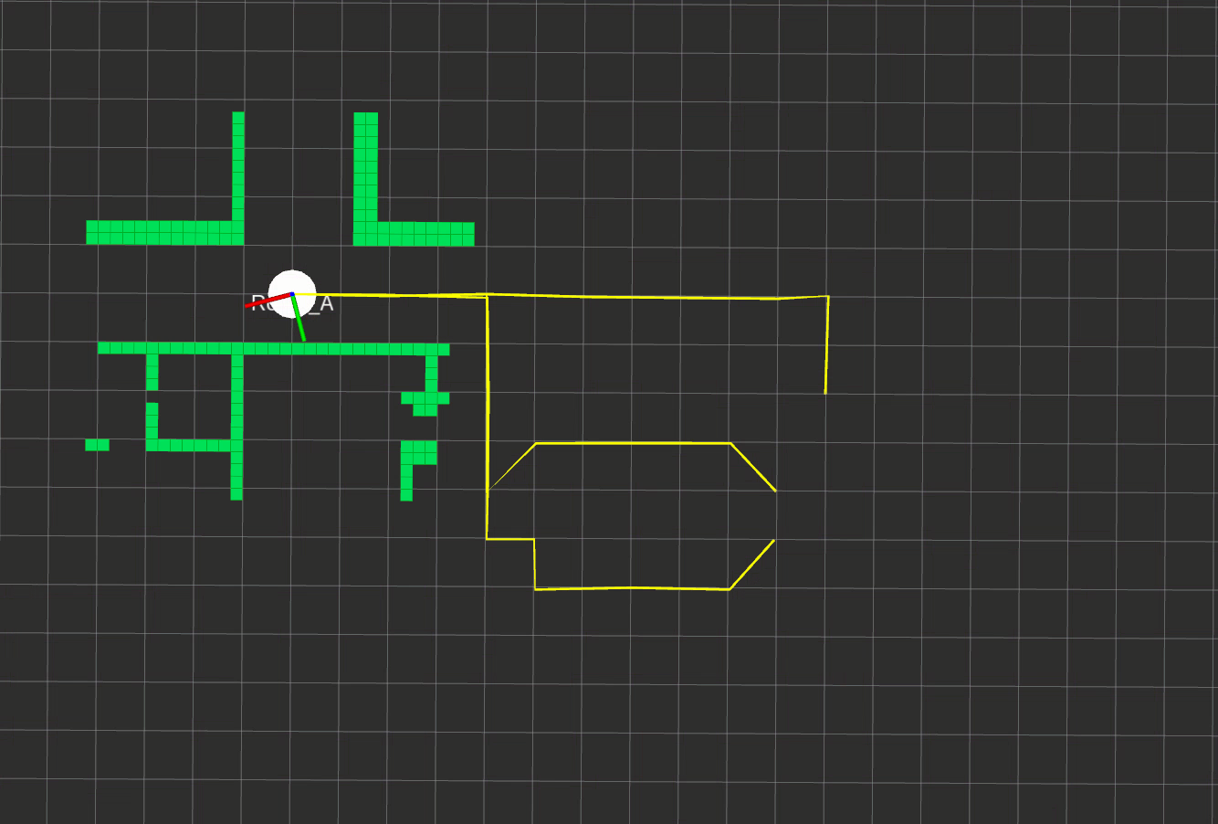
Introduction – Decision Making
Belief Space Planning (BSP)
Planning in Unknown Environments
S. Prentice et al., IJRR 2009
Notes:
Another task in autonomous navigation is decision making. The agent generates candidate actions and it needs to choose which action will lead to the best outcome. As you can see in this image, action 1 or 2. One method to deal with this problem is belief space planning. Using BSP, the agent performs belief propagation, by a very similar process like it did in SLAM but now the agent does the expectation calculation for a future time. Next, considering this expectation the agent calculates the defined objective function and chooses the action with the highest value of the objective function. In this example, the objective function is the expected uncertainty.
But, when the action leads to unknown environments the BSP has some limitations. Existing approaches Currently perform belief propagation within unexplored areas by only considering uncertainty due to motion model and without explicitly modeling the expected sensor observations (pic) Because the map is missing. In this work we suggest an approach that aims to deal with this problem by adding knowledge and predicting the unknown map.

Slide 4
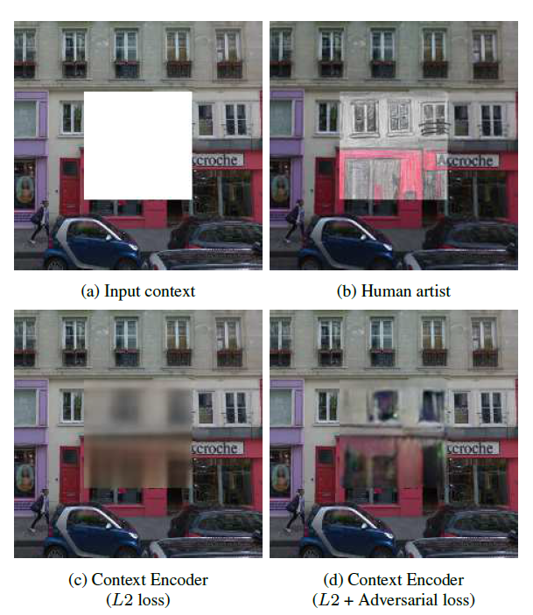
Introduction – Inpainting
Image completion task
Addressed by DL based generative models:
Variational Autoencoders (VAE)
Generative Adversarial Network (GAN)
Extended map task
D. Pathak et al., CVPR 2016
Notes:
related to the map prediction task is the Inpainting problem. In this case, we have an image with a missing part and the task is complete it. Here, in the top right, you can see an example to how a human can do this mission. If a human can do it, it makes sense that the DL based on generative models can also handle this task. There is many work in this subject, most of them used VAE or GAN.
though our problem isn’t picture completion, rather an extended map, we just drew inspiration from the in-painting problem. The extended map task is a much more challenging problem that only a few studies have addressed because of the ratio between the conditioning to the missing part, and the occupancy grid being less rich in information and with less repeat structures.
So, we decided to use similar technics as the in-painting problem, for the development of a map prediction algorithm that will aim to improve BSP in unknown environments.

Slide 5
Related Works
Belief Space Planning in unknown environments
A. Kim et al.: “Active visual SLAM for robotic area coverage: Theory and experiment”, IJRR 2015.
V. Indelman et al.: “Planning in the continuous domain: A generalized belief space approach for autonomous navigation in unknown environments”, IJRR 2015.
V. Indelman: “Cooperative multi-robot belief space planning for autonomous navigation in unknown environments”, ARJ 2017.
V. Indelman et al., IJRR 2015
V. Indelman, ARJ 2017
Notes:
Since 2015, we saw works on BSP in unknown environment. I want remark that This task is very changing because here we want consider the information-theoretic reward (in other word the future uncertainty of the robot) but without accessing to the map. For example, The Indelman 15 paper suggested to consider the landmarks that were seen up current time but assume the other area is free from landmarks. (pic) You can see the left picture, the drone starts from this point with a low uncertainty(the colorful ellipse represent here uncertainty). And you can see, when it fly from this point (pic) to here(the next goal) (pic) it choses to loop closure with the landmarks from the start point, for decrees his uncertainty.
In the right picture you can see another work of Vadim which talks about Cooperative multi-robot belief space planning for autonomous navigation in unknown environments. Here, you can see example of two robots. the white area represents the environment that is covered up current time, and the gray area is the unknown environment. For each robot there is a goal and they need to choose the best path to the goal. The main contribution here is in the planning process, where the robots consider future information sharing (similar to loop closure but now with other robots states). This means that if the paths will be close enough to each other they will probably observe shared landmarks.

Slide 6
Related Works
Reinforcement Learning (RL) in POMDP setting
P. Karkus et al.: “Qmdp-net: Deep learning for planning under partial observability”, NIPS 2017.
G. J. Stein et al.: “Learning over subgoals for efficient navigation of structured, unknown environments”, CORL 2018.
G.J.Stein et al., CORL 2018
Notes:
Experience-based navigation or planning is usually linked to reinforcement learning (RL). RL and BSP both share the same goal of finding the optimal action, but there are differences
in approaches.
In RL the policy is mostly learned offline based on experience from similar missions. Also, RL mostly considers a Markov decision process (MDP) problem, that is, the state is fully observable. Recently several works addressed (deep) RL under POMDP setting, such as the Karkus 17 work mentioned here, but they focused on a different task from us- like active localization when they assume the map is known.
More closely related to us are learning approaches that consider autonomous navigation in unknown environments, like the Stein 18 work. Stein learned by NN the probability of succeeding in reaching the goal, the success cost (is it path feasibly or not?), and the exploration cost. They claim these terms are computationally intractable, because there are implicit expectations over the future belief bt+1. Note they give end-to-end solution (different method from us), and solve a different task- which is a feasibility task and not to minimize future uncertainty, as we are attempting.

Slide 7
Related Works
Experience for Planning in unknown environment
C. Richter and N. Roy: “Safe visual navigation via deep learning and novelty detection”, RSS 2017.
K. Katyal et al.: “Uncertainty-aware occupancy map prediction using generative networks for robot navigation”, ICRA 2019.
C. Richter et al., RSS 2017
K. Katyal et al., ICRA 2019
Notes:
Here you can see two papers that used experience for planning in unknown environment.
For example, Richter and Roy 17, trained a classifier function for safe visual navigation. The mission is given an image and candidate action, to estimate the probability to crash with the wall.
Even more similar to our work is the Katyal 19 work. Katyal used a NN for map prediction that assisted an efficient exploration of unknown Environments.
Our approach belongs to this category as well, as we utilize the classic model based on BSP and incorporate experience-based map prediction only for the unexplored environments.
So these works belongs to same category but solved different tasks.

Slide 8
Problem Statement
Current BSP methods lack the information necessary to predict future measurements in unknown environments.
Contributions:
predict distribution over an unexplored area for future measurements generation
incorporate experience-based prediction within BSP. In particular, with information-theoretic costs.
Notes:
Okay, now let's try to understand the problem and the main contributions of this work:
Current BSP methods lack the information necessary to predict future measurements in unknown environments.
Therefore, in this work we developed a map distribution prediction algorithm of the unexplored area for future measurements generation and the incorporation of these within BSP. In particular, we focused on planning task that consider the information-theoretic costs. This combination has not been done yet to the best of our knowledge.

Slide 9
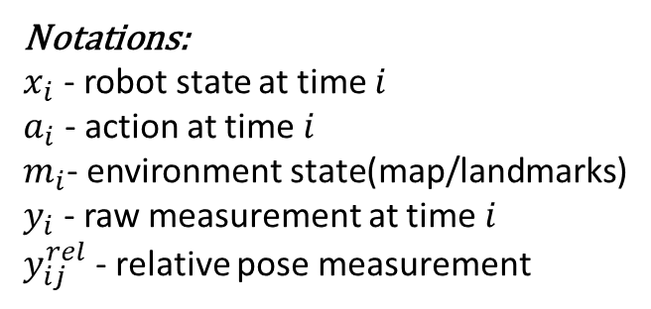
Problem Formulation - SLAM
Motion model
Observation model of a raw measurement
Observation model of a relative-pose measurement
Notations:
$x_{i}$ - robot state at time $i$
$a_{i}$ - action at time $i$
$m_{i}$- environment state(map/landmarks)
$y_{i}$ - raw measurement at time $i$
$y_{ij}^{rel}$ - relative pose measurement
Notes:
Now we will dive into the formulation and start with SLAM. First we will be basing on motion and observation models
with additive Gaussian noise. (eq) here you can see The motion model that given action, ai-1, and robot state, xi-1, we get the next robot state xi(up to the noise wi).
The generative/measurement model for the raw measurements (like images, point clouds) thus depend both on the robot state, xi, and the environment state, mi (eq)
Using two raw measurements, yi and yj , we can create a relative pose measurement y^rel_ij between two robot poses xi and xj (eq). When the raw measurements are point clouds, the algorithm could be ICP or Visual Odometry (VO) in the raw images measurement case.
Importantly, while the covariance (sigma_v) is assumed constant in most previous works, in practice it is a function of the raw measurements and thus the map.

Slide 10
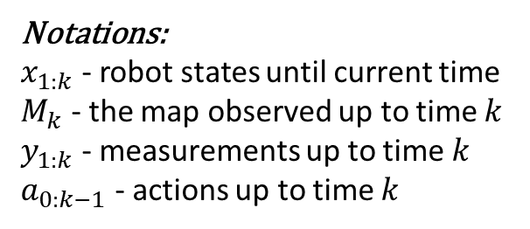
Problem Formulation - SLAM
Robot’s state belief
Map belief
Notations:
$x_{1:k}$ - robot states until current time
$M_{k}$ - the map observed up to time $k$
$y_{1:k}$ - measurements up to time $k$
$a_{0:k−1}$ - actions up to time $k$
Notes:
I remined the notations: Here, X denotes the robot states/poses, M denotes the map observed, y denotes observations and a is actions.
Like we talked in the introduction, SLAM produces two outputs: the robot state posterior, b_k, (we call that the robot state belief) and a Map belief, M_k. Both of them depend on the history, that mean, the actions and observation up to current time.

Slide 11
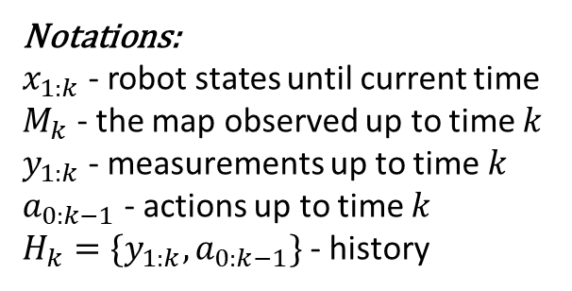
Problem Formulation - BSP
Future belief
Objective function
Optimal action
Notations:
$x_{1:k}$ - robot states until current time
$M_{k}$ - the map observed up to time $k$
$y_{1:k}$ - measurements up to time $k$
$a_{0:k−1}$ - actions up to time $k$
$H_{k}=\{y_{1:k},a_{0:k−1}\}$ - history
Notes:
(point belief-eq) In BSP we want to calculate the future belief that depends not only on history, but also on the candidate actions and future observations.
(point to J-eq) The objective function given by this equation where the cost c is a function of the posterior future belief which by itself depends on future observations. The expectation operator accounts for all possible realizations of these future observations. To do so, we should be able to predict future observations, and approximate the expectation, typically via sampling.
(point to a*-eq) The optimal action is the action with the minimum objective function.

Slide 12
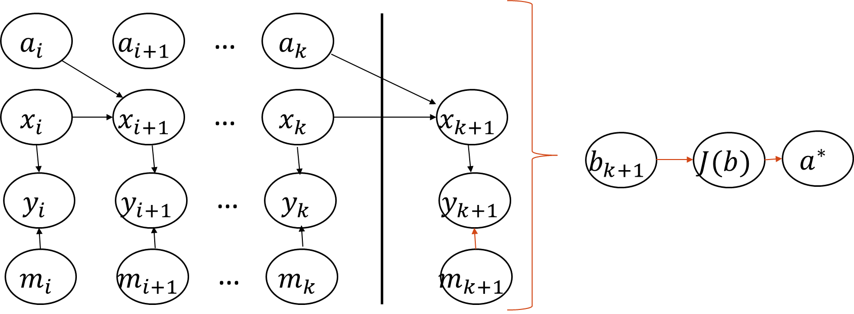
Problem Formulation
Inference (by SLAM)
Planning (by BSP)
Actions
Optimal next action
Objective function
Belief
Robot states
observations
Map states
Notes:
This diagram shows the problem that we are dealing with. You can see the inference stage and the planning stage. In order to generate observations, the map and robot states are required (show the connections).

Slide 13
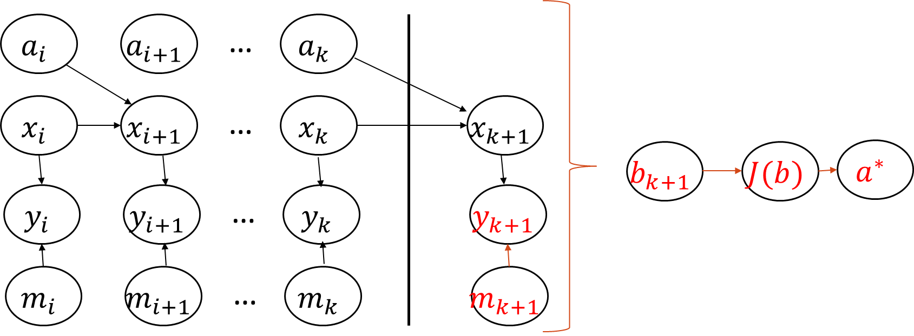
Problem Formulation
Inference (by SLAM)
Planning (by BSP) in Unknown Environments
Actions
Optimal next action
Objective function
Belief
Robot states
observations
Map states
?
Notes:
In our case, we focus on a situation where the goal is outside the map and therefore there is no access to future measurements, currently these variables(y,m_k+1 in the red color) are uninformative. Also we see the decision making depends on this measurements. To address this problem we would like to incorporate experience in the planning stage. Adding experience for m_k+1 prediction.

Slide 14
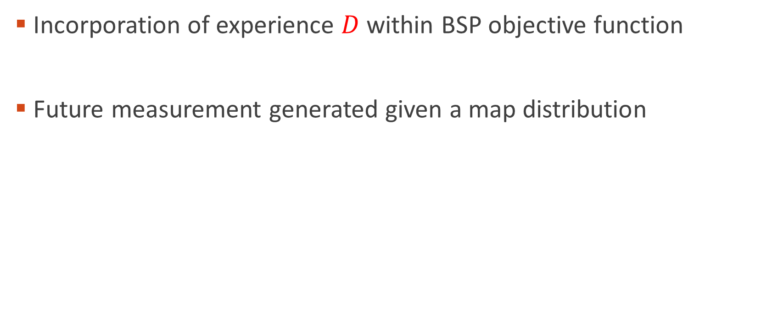
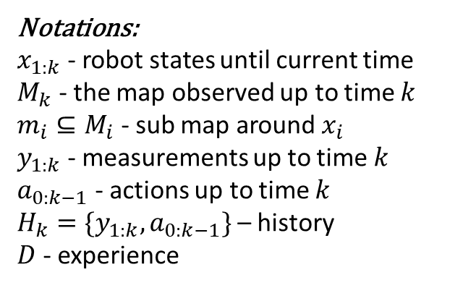
Approach
Incorporation of experience $D$ within BSP objective function
Future measurement generated given a map distribution
Notations:
$x_{1:k}$ - robot states until current time
$M_{k}$ - the map observed up to time $k$
$m_{i}⊆M_{i}$ - sub map around $x_{i}$
$y_{1:k}$ - measurements up to time $k$
$a_{0:k−1}$ - actions up to time $k$
$H_{k}=\{y_{1:k},a_{0:k−1}\}$ – history
$D$ - experience
Observation model
?
Notes:
Here we show you the main development of equations.
First, we incorporated available experience D within the objective function and rewrote the expectation as integration and sampled over y distribution (future observation).
(point on Py|x,m) To sample future observations yk+1 by observation model, we marginalize over the robot state (maximum likelihood estimate) and the next sub map m_k+1. So, for sampling future measurement, we sample over future map distribution. here (point on Pm) is where we propose to leverage experience, D.

Slide 15
Approach
Future measurement generated given a map distribution
Experience-based prediction of map distribution
Observation model
?
Notations:
$x_{1:k}$ - robot states until current time
$M_{k}$ - the map observed up to time $k$
$m_{i}⊆M_{i}$ - sub map around $x_{i}$
$y_{1:k}$ - measurements up to time $k$
$a_{0:k−1}$ - actions up to time $k$
$H_{k}=\{y_{1:k},a_{0:k−1}\}$ – history
$D$ - experience
Notes:
Now our task is learned the future map distribution by Experience-based prediction approach.
First, in order to use the available current Map belief from SLAM we marginalize over (capital)M_k. second, because the map grows over time, we use only the sub-map with a constant dimension, lowercase m_k. Note our framework is general and we took the last simplifying assumption since the input in DL methods usually is a constant dimension, and that more practice for the implementation.

Slide 16
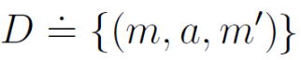
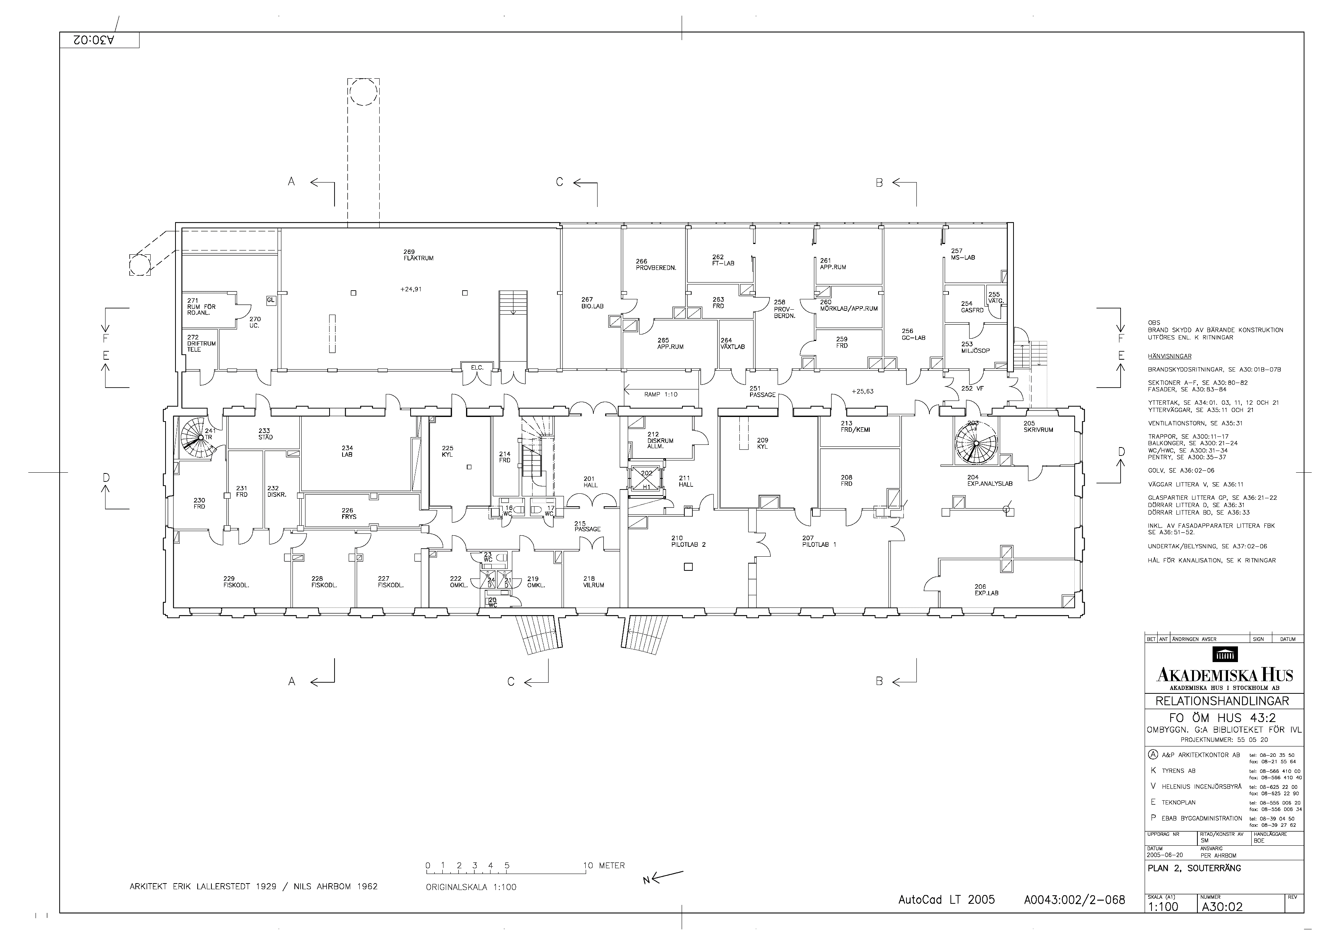



Approach – Map Prediction
Purpose – learn the future map distribution offline
Data Set - floor plans (KTH)
1m Left
Notes:
Now we focus on the purpose to learn the future map distribution offline. The conditioning of this distribution is the sub-map and action. For this purpose We used a data-set of floor plans, -> transformed to occupancy grids and finally we created our data set that included sequences of the conditioning (m,a) and the ground truth prediction results m’.

Slide 17
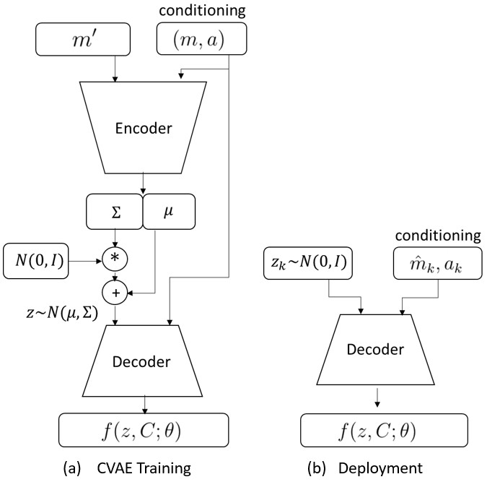
Approach – Map Prediction
CVAE architecture
Encoder
Decoder
Loss function
Notes:
In our work we chose using conditional VAE architecture which includes two NN: Encoder and Decoder. In this case the encoder maps from the conditioning and gt-map to the latent variable z. The decoder maps from z and the conditioning to map prediction. The Loss involves two components: one is the error between the prediction to the GT and second is the distribution distance between the encoder output to a normal distribution that is easy to sample from in the deployment stage. So this is the training process and when online(in the deployment stage) we will use only the trained decoder.

Slide 18
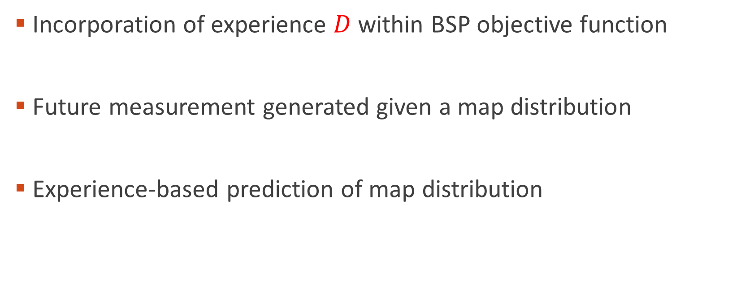
Approach (Reminder)
Incorporation of experience $D$ within BSP objective function
Future measurement generated given a map distribution
Experience-based prediction of map distribution
Notations:
$x_{1:k}$ - robot states until current time
$M_{k}$ - the map observed up to time $k$
$m_{i}⊆M_{i}$ - sub map around $x_{i}$
$y_{1:k}$ - measurements up to time $k$
$a_{0:k−1}$ - actions up to time $k$
$H_{k}=\{y_{1:k},a_{0:k−1}\}$ – history
$D$ - experience
Notes:
Just For a remainder, we learned this distribution by CVAE, given this distribution we generate future mesurments and calculate the BSP objective function. So we based on experience for the desicion making task, But, incorporating experience doesn’t necessarily improve results in all cases. A Question that you could ask is: Is the experience relevant and reliable for the current task?

Slide 19
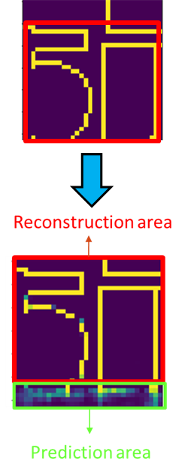
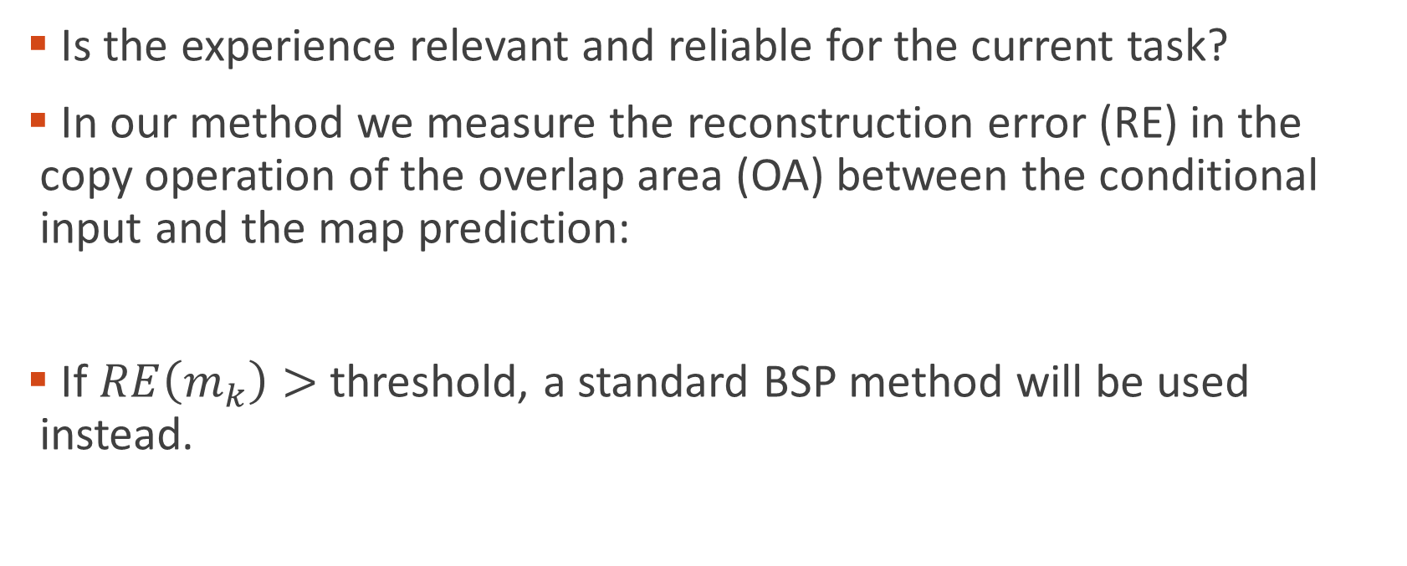
Approach – Novelty detection
Is the experience relevant and reliable for the current task?
In our method we measure the reconstruction error (RE) in the copy operation of the overlap area (OA) between the conditional input and the map prediction:
If $RE\left(m_{k}\right)>$ threshold, a standard BSP method will be used instead.
Notes:
In order to detect some of these cases where experience isn’t relevant, we suggested the novelty detection method. Novelty detection detects the cases where the conditioning is very different from the dataset examples, and therefore, may lead to a wrong prediction.
(point to the example) In our method we measure the error in the copy operation of the overlap area (OA) between the conditional input and the map prediction.
If $RE\left(m_{k}\right)$ higher from defined threshold, the available experience is based on data that isn’t similar enough to the current case, and therefore, a standard BSP method will be used instead.

Slide 20
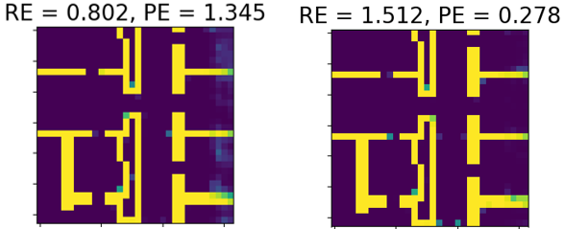
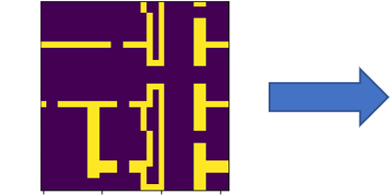

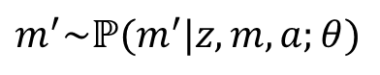
Results – Map Prediction
Example 1 - most predictions are correct (low prediction error (PE))
Conditioning
$$m^{′}\sim ℙ(m^{′}|z,m,a;θ)$$
Map
Action
Worst sample
Best sample
Ground truth
Notes:
Here we show map prediction results on the test set. In the left the conditioning consists of a sub map and action (here, move to the right). The next two images show two samples- the left shows the worst prediction and the right the best results (the different between them is just different z). The last right column is the GT results. We will show here three examples that represent three families of prediction. First example represent the cases when most predictions are correct (low PE) even in the worst case.

Slide 21
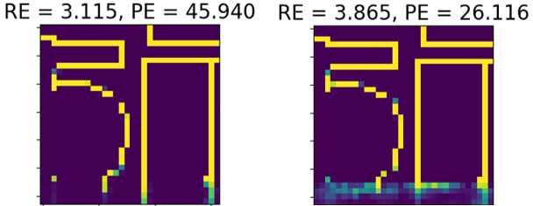
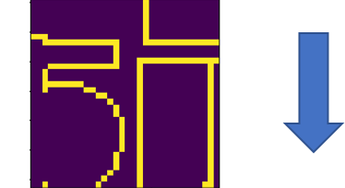

Results – Map Prediction
Example 2 - most predictions are wrong because of an unfamiliar input (high PE and high RE).
Conditioning
$$m^{′}\sim ℙ(m^{′}|z,m,a;θ)$$
Map
Action
Worst sample
Best sample
Ground truth
Notes:
The second example represents the second family - most predictions are wrong because of an unfamiliar input (high PE and high RE). The half circle shape is non-common shape in the dataset, so the RE is high in this case.

Slide 22
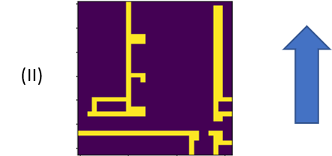
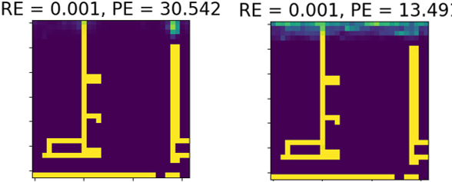

Results – Map Prediction
Example 3 - most predictions are wrong because of uncommon ground truth map (high PE and low RE)
Conditioning
$$m^{′}\sim ℙ(m^{′}|z,m,a;θ)$$
Map
Action
Worst sample
Best sample
Ground truth
Notes:
The third example represents the last prediction family - most predictions are wrong because of uncommon ground truth map (high PE and low RE); this family type is problematic for our method because these cases can’t be detected online by novelty detection.

Slide 23
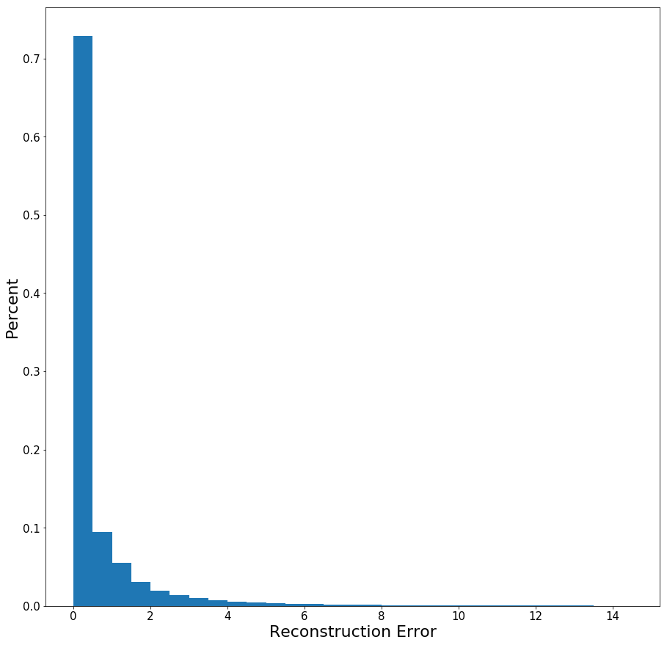
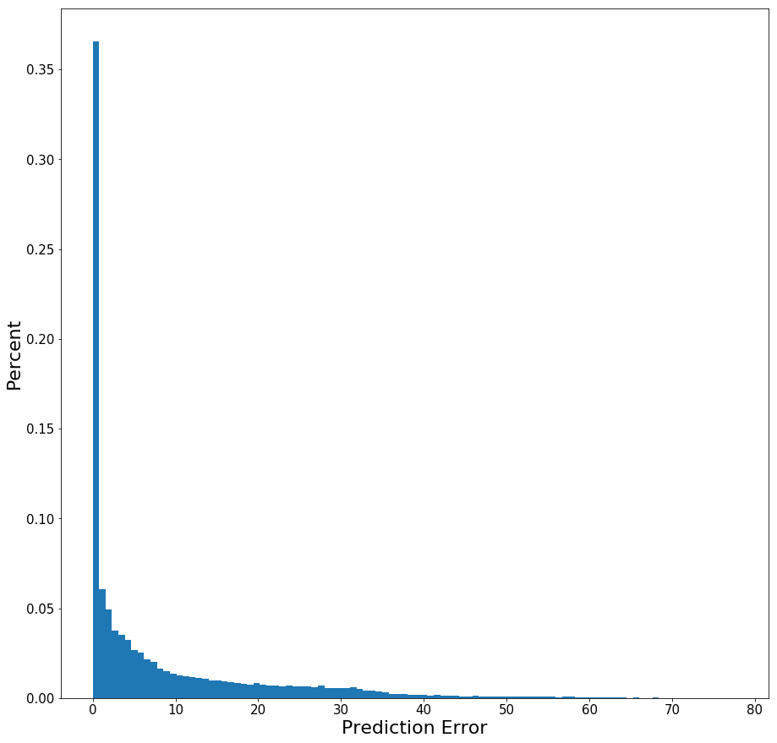
Results – Map Prediction
Reconstruction area
Prediction area
Reconstruction and prediction error of the test set
Notes:
(point to PE figure) Yet, statistically we show on the testset, that in most cases the online map will be of a similar nature as the dataset maps like example 1 (right figure- most the scenarios with low PE). thus, we assume the prediction will improve the decision making process in most cases.
Also, by using The left figure we can define the RE threshold (<5).

Slide 24
BSP with Experience-Based Prediction
Inputs:
State belief
Map belief
Candidate action
Trained decoder
Output:
computed objective function
Notes:
Now we present the online process of BSP with Experience-Based Prediction. The inputs are State belief, Map belief, specific Candidate action and Trained decoder.
The output is a computed objective function which is an approximation to the one I presented before.

Slide 25
BSP with Experience-Based Prediction
Get current sub-map
Double loop and initialization
Notes:
First, we convert the current map belief to the relevant sub-map around the robot.
Next steps will be in double loop. First loop for N samples and loop for L steps action sequence.

Slide 26
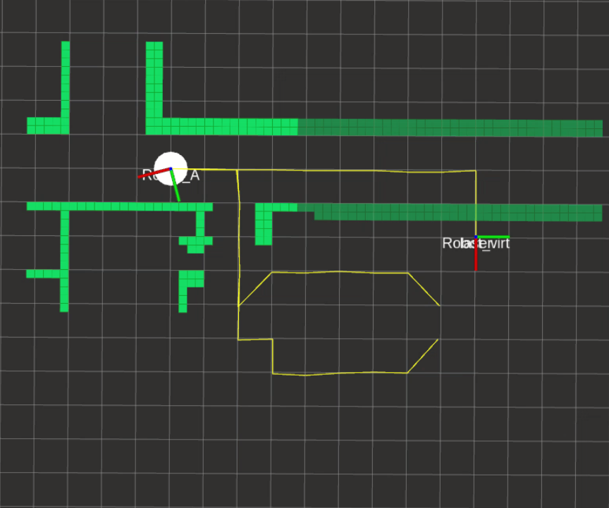
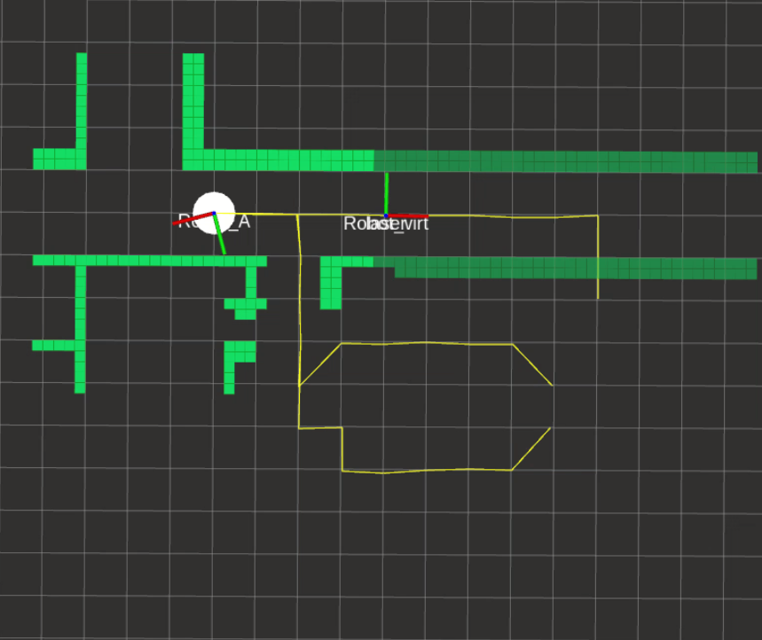
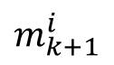
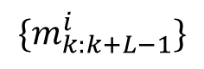
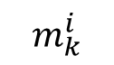
BSP with Experience-Based Prediction
Prediction of next sub-map
$${\{m}_{k:k+L−1}^{i}\}$$
$$m_{k}^{i}$$
$$m_{k+1}^{i}$$
Conditional map in light green, predicted map in dark green.
Notes:
Next, we predict the samples of the next sub-map using the trained decoder. (point to image) This is after one step and here is a merging of all the sub-maps around the candidate action up time k+L.

Slide 27
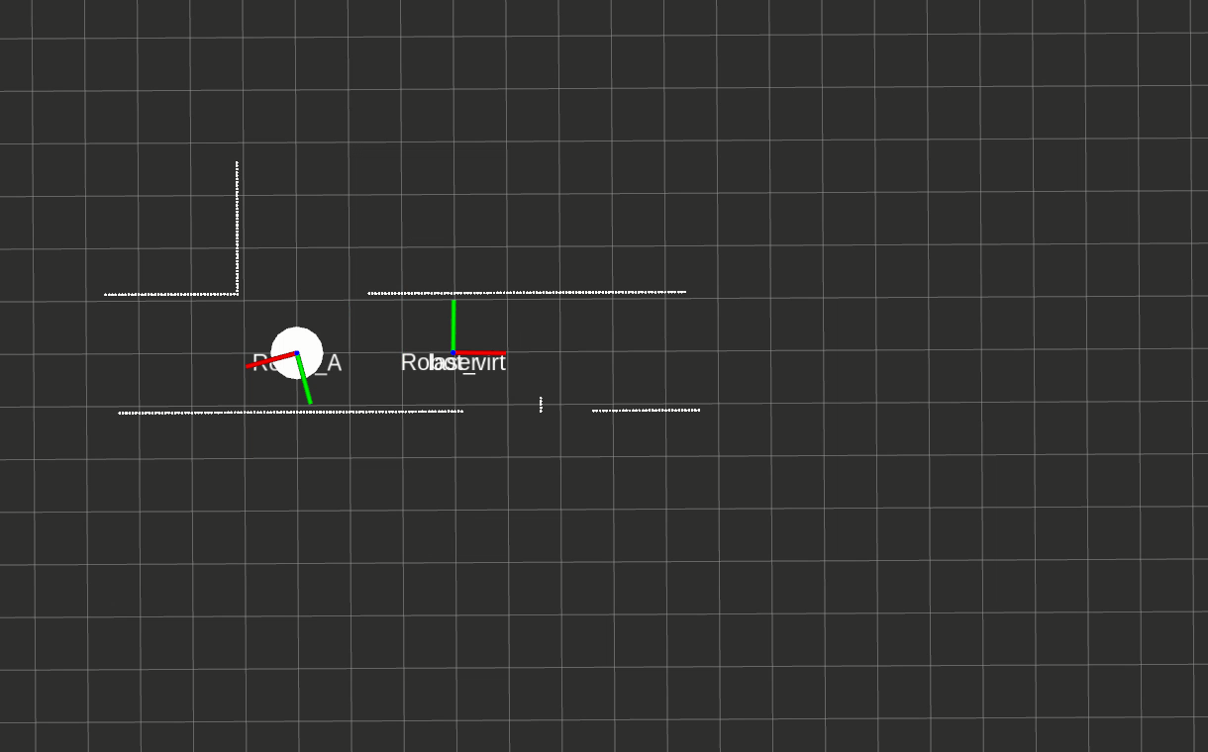
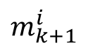
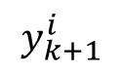
BSP with Experience-Based Prediction
Generation of future observation
$$m_{k+1}^{i}$$
$$y_{k+1}^{i}$$
Notes:
Afterwards we generate the future observation according to the map prediction sample. In this example the measurement is point cloud.

Slide 28
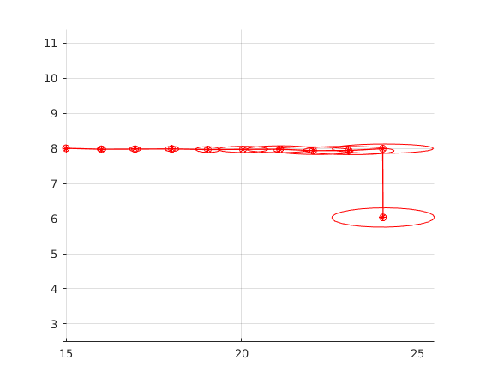
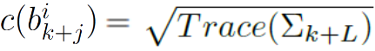
BSP with Experience-Based Prediction
Calculation of future belief using the generated observation
Calculation of the cost function
Notes:
Next, we update the belief propagation with the generated observation. And we calculate the cost function. In our case we chose the cost to be the trace of the uncertainty of the last pose

Slide 29
BSP with Experience-Based Prediction
Calculation of the objective function
Notes:
Finally we calculate this objective function that averages the costs of all the samples

Slide 30
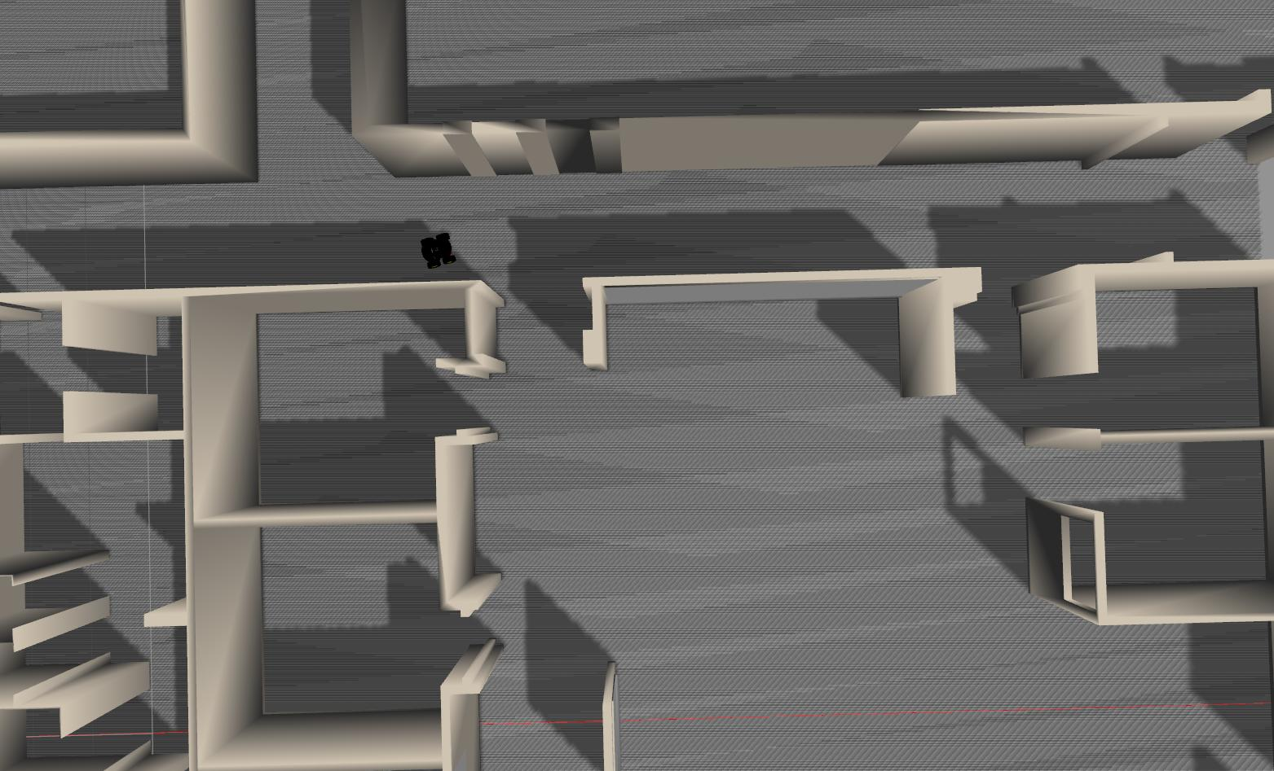
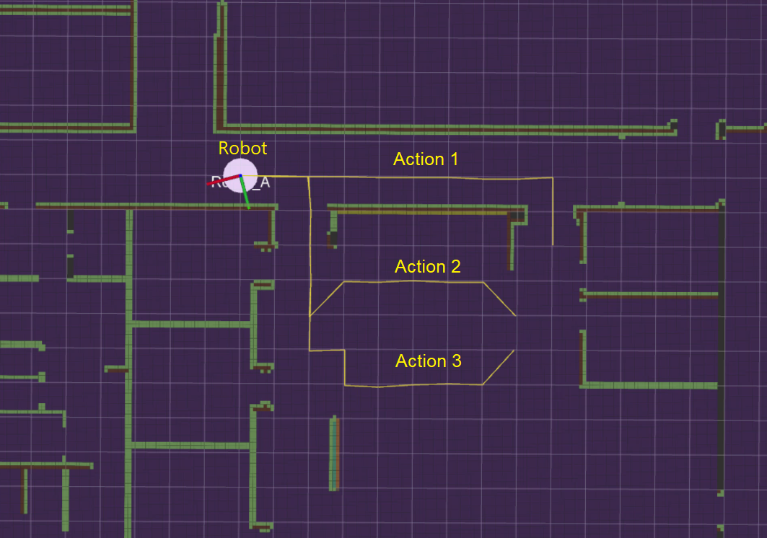
BSP Simulation Results
Notes:
In order to examine our approach we compered it against existing BSP in a Gazibo simulation. The task is to choose the best action between these three action options(in the right Fig).

Slide 31
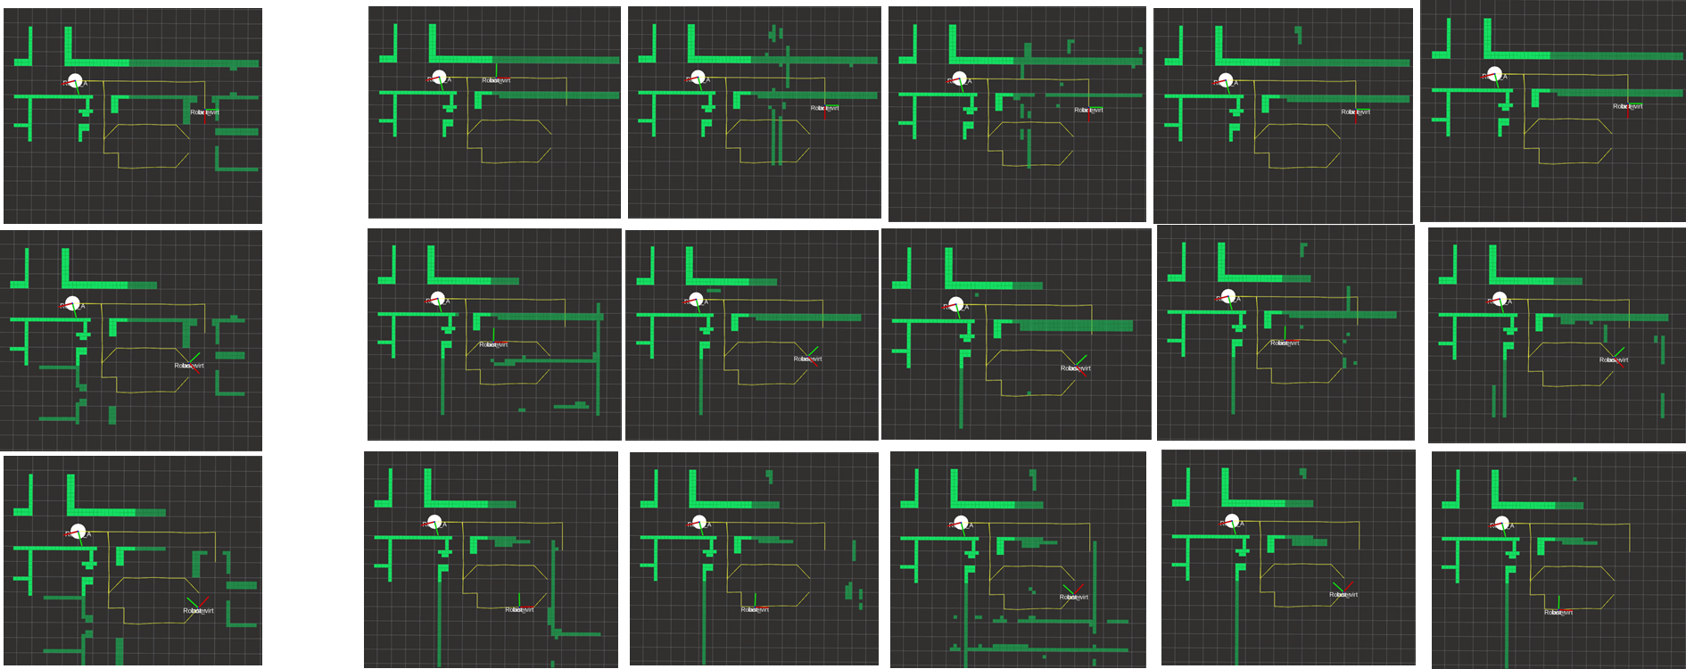
BSP Simulation Results
Ground truth
Samples
Action 1
Action 2
Action 3
Conditional map in light green, predicted map in dark green.
Notes:
Here are the ground truth result of the three action options.(klik)
Here you can see results of five samples for each action. The Conditional map in light green, predicted map in dark green.
Though there is much to be done to improve the results, the current performance shows that we predicted right the type of the future environments (as you can see the corridor for action 1 and room/open spaces for actions 2,3).

Slide 32
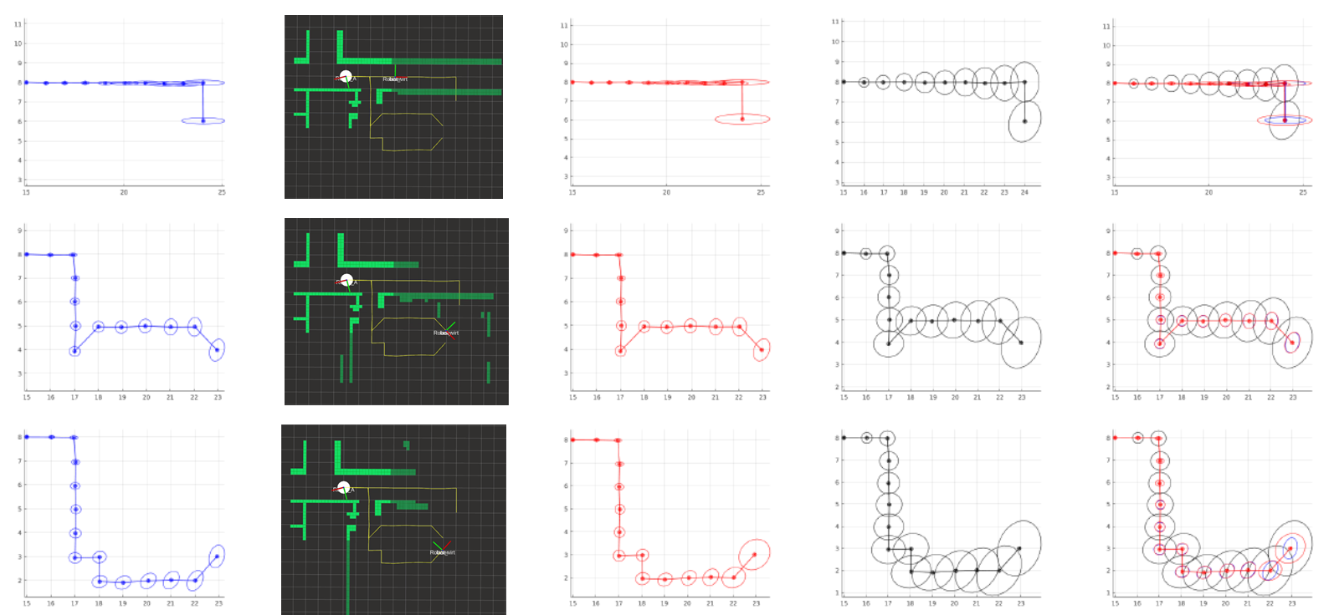
BSP Simulation Results
Ground truth
Samples
Our approach
baseline
comparison
Action 1
Action 2
Action 3
Notes:
We did Comparison between three methods of uncertainty evolution on three different actions. First the optimal case when the robot using the GT of the future map(click), our method – you can see, when there is a different environment there is different uncertainty shape evolution(click) in the black is the baseline method, that considers only the motion model(click), and Comparison of all methods.
We can see our approach (in red) predicts the uncertainty shape better than the baseline (in black), respect to the GT (point on GT).

Slide 33
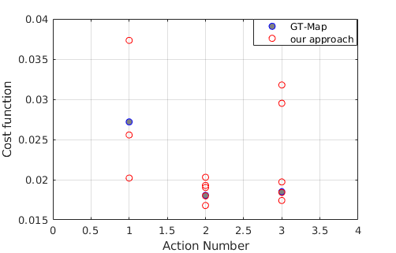
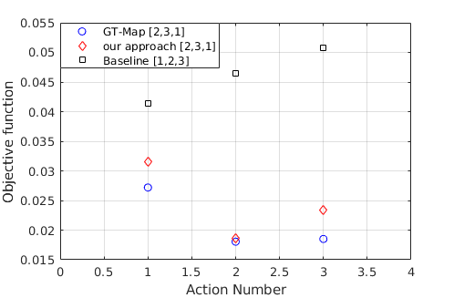
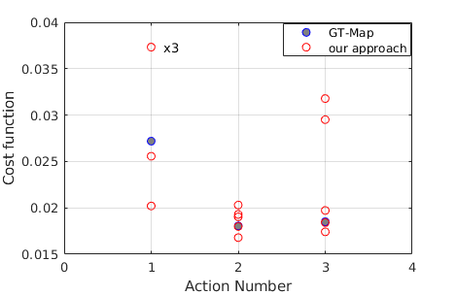
BSP Simulation Results
Notes:
More results of this scenario-
The figure in the left summarizes the Cost function results of all the samples from the previous Figures compared to the cost function calculated with the GT-map method. The red circles represents the costs of each sample.
The figure in the right shows Objective function values for the three methods. In contrast to baseline BSP, our approach has an identical action-ordering as the GT. (point to the action-ordering).

Slide 34
BSP Simulation Results
The table reports for each method the number of action ordering mistakes with respect to BSP with ground truth map, and the uncertainty cost error.
Notes:
Finally, we did the same comparison in 15 different cases and summarized it in this table. The table reports for each method the number of action ordering mistakes with respect to BSP with the ground truth map. Our method was preferable in 9 of the cases, against only 1 case when the baseline won. Also, We can see that our approach
yields an improved uncertainty cost error.

Slide 35
BSP Simulation Results
Using the novelty detection method we recognized unfamiliar environments and avoided using our approach in these cases (e.g. Sc. 15).
Sc. 15
Notes:
Also, As you can see scenario 15 is very different from the dataset. We calculated the reconstruction
error for all scenarios and showed that using the novelty detection method we recognized unfamiliar environments and avoided using our approach in these cases.

Slide 36
Summary
Development of an algorithm that calculates a predicted distribution over an unexplored area using a deep learning method
Incorporation of this distribution within BSP (considering information-theoretic costs)
Novelty detection for map prediction
Gazebo simulation compared our approach to existing BSP approaches - results indicate the potential of our approach to improve decision making in unknown environments
Notes:
In conclusion, we developed an algorithm that calculates a predicted distribution over an unexplored area using a deep learning method,
And we Incorporated this distribution within BSP.
We suggested Novelty detection method for map prediction.
Finally, we compered our approach to existing BSP approaches in real Gazebo simulation. The results indicate the potential of our approach to improve decision making in unknown environments.

Slide 37
Conclusions and Future Work
Good interpretability
Low sensitivity to prediction mistakes
Evaluation of path feasibility; improvement of map prediction accuracy is needed.
Future work may extend our novelty detection method to cases with familiar inputs that still provide wrong predictions.
Notes:
we believe a benefit of our approach is in its interpretability, that mean are algorithm is easer to debug, since the use of experience in our method is done only at the prediction level, as opposed to end-to-end methods which involve experience all through the decision making process.
Moreover, as our work focused on the uncertainty estimation of future observations, it depends
mostly on the type of unexplored area (like corridor or room) rather than the exact outline, and therefore is less sensitive to prediction mistakes. (respect to feasibility task).
It is also possible to envision utilizing a similar concept for evaluating path feasibility; however,
to this end, further work is needed to improve map prediction accuracy.
Last point, currently our novelty detection approach miss the cases with familiar inputs that still provide wrong predictions, so we suggest in future works to extend the novelty detection for this cases. (this mission isn’t trivial, it’s a general problem in Learning approaches).

Slide 38
Thank you for listening. Questions?
asromri@gmail.com

